Slide 1
Bush 41 and Clinton
A New Era: Post Cold War

Slide 2
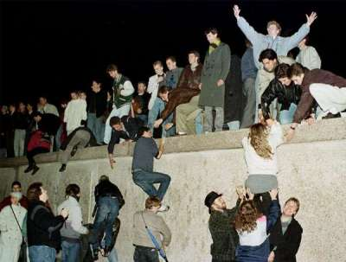
George H. W. Bush
End of Cold War/waning power of the Soviets
May 1989: Hungary opens the border to Austria: the “Iron Curtain” is breached.
June 1989, Solidarity wins elections in Poland
The Berlin Wall falls on November 9, 1989
September 1991: Congress of People’s Deputies of the USSR votes to dissolve the Soviet Union
December 25, 1991: Gorbachev resigns as leader of USSR
December 26, 1991: Russian government takes power in Moscow.
The US emerges as lone superpower

Slide 3
George H. W. Bush
More pragmatic, less ideological
Ultimately perhaps the most popular US President by the end of his term since JFK.
Negotiations in Central America+ political pragmatism in the face of the end of the Cold War.
Aid continues to Nicaraguan opposition (support for UNO coalition for the election of Chamarro)
Debt relief (Brady and Baker plans)
NAFTA/FTAA
Changes vis-à-vis Mexico

Slide 4
Operation Just Cause
“The goals of the United States have been to safeguard the lives of Americans, to defend democracy in Panama, to combat drug trafficking and to protect the integrity of the Panama Canal Treaty.”
-President George H. W. Bush (December 21, 1989) in an address to the nation on his decision to use force in Panama

Slide 5
Operation Just Cause
Objectives (PLAN 90-2):
Protect U.S. lives and key sites and facilities.
Capture and deliver Noriega to competent authority.
Neutralize PDF forces.
Neutralize PDF command and control.
Support establishment of a U.S.-recognized government in Panama.
Restructure the PDF.

Slide 6
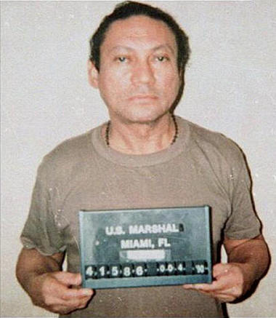
Operation Just Cause: Timeline
December 15, 1989: Panamanian government declares a state of war with the US; a US Marine is shot
December 20, 1989-December 24, 1989
January 3, 1990-Manuel Noriega surrenders to US authorities.

Slide 7
Bush: A Shift to Democracy Promotion
“If during the Cold War years Washington’s principal concern was how to prevent communism from taking root in the New World, by 1990 it was how to consolidate democracy and fuel economic prosperity with the free market system” (Raymont, 271).

Slide 8
Bush: A Shift to Democracy Promotion
SecState Eagleburger in 1990 from a speech given at that old Congress Building in Chile:
“I will not deny that my own country bears its share of responsibility for having tended to view our hemispheric relationships through the sometimes distorting prism of the Cold War…But mistakes were made, the most serious being a failure at times to take out hemisphere on its own terms and to deal with its problems in their own right” (Raymont 273).

Slide 9
Post Cold War Era
A NEW GAME (YET AGAIN)
THE COLD WAR ORDER PASSES AWAY
Dissolution of the Soviet Union and the Eastern Bloc
US emerges as “victor” of the Cold War
bipolarity is dead, welcome back multipolarity?
NEW RULES FOR AN ERA WITHOUT A COOL NAME (although Smith calls it the “Age of Uncertainty”)
Absence of clear rules of the game
“Unipolar Supremacy” (?) (Smith, 222), or, perhaps one big pole and lots of tiny ones or “uni-multipolar” as per Huntington (Smith, 228).

Slide 10
Post Cold War Era
Six scenarios in Smith (229-230)
US global hegemony
Intensification of multipolarity
Clash of civilizations
Formation of Rival Blocs
North-South Separation
Continuing Globalization

Slide 11
Post Cold War Era
Economics and Trade become the issues of the day
major competitors with US=EU, Japan
US continues to grow (after some initial concerns over relative decline) as an economic power
nature of international threats is now different
Global confrontation not the issue
Regional conflict/terrorism
Democracies flourish: war, therefore, unlikely (Democratic Peace Theory)

Slide 12
Post Cold War Era
ECONOMICS START TO BE CENTRAL IN THE 1980S
Debt crisis of the 80s
Exhaustion of ISI and the advent of neoliberalism sets the stage for the 90s and the emergence of trade as a key global issue
Democratization of the hemisphere

Slide 13
Post Cold War Era
SHIFT IN HEMISPHERIC RELATIONS
Democracy and development rhetorically still at center stage, and perhaps with more genuineness than ever (although still self-serving, perhaps: discuss. i.e., what do we need from the hemisphere now?)
US hegemony a given, so none of the games of the “American Lake” days.
Left, no longer an issue
Security issues: drugs, immigration, trade (how might trade be a “security” issue?), some concern over regional conflict and lingering insurgencies.
Some concern over breakdowns of democracy/regime transitions (Peru, Venezuela, Cuba)
Development still a forefront issue (and at differing levels across the hemisphere)

Slide 14
Bill Clinton
Some talk, less action (normal pattern)
NAFTA
Haiti
Summit of the Americas (Miami)
More FTAA talk/fast track/Chile
Peso Crisis bail-out
Plan Colombia/War on Drugs

