Slide 1
Carter
Human Rights and Revolution

Slide 2
Carter
Personal Interest
Human Rights (not an absolute view)
Panama
Nicaragua (and linkage to Iran)
El Salvador (see 228 in Raymont)
“Good Intentions Poorly Executed” (Raymont 220)
Mexican state visit and “Montezuma’s Revenge”

Slide 3
Nicaragua: Selected Timeline
1927-1934: After five hundred battles fought against U.S. marines and sympathizers, Sandino successfully expels U.S. armed forces from Nicaragua.
1934: The U.S. withdraws, leaving Nicaraguan military officer, Anastasio Somoza García as Commander of the National Guard.
1934: Somoza masterminds the assassination of Augusto César Sandino (with the encouragement of the US).

Slide 4
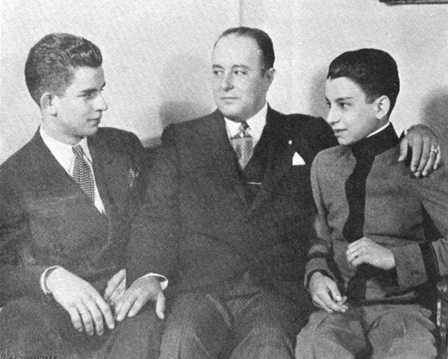
Nicaragua: Selected Timeline
1936: Anastasio Somoza García founds a dictatorship which is passed from father to son to brother.
Three Pillars of the Somoza dynasty:
Control of the National Guard
Manipulation of the Liberal Party
Alliance with the United States

Slide 5
Nicaragua: Selected Timeline
1956: Anastasio Somoza García is assassinated and succeeded by his son, Luis Somoza Debayle. For four years after his son's regime, close associates of the Somoza family maintain political control of Nicaragua.
1966: Luis Somoza Debayle makes René Schick president .

Slide 6
Nicaragua: Selected Timeline
1967: Luis dies of a hear attack, making his brother, Anastasio, the country’s leader and he assumes the presidency.
1971: Anastasio Somoza Debayle steps down from government, but retains the post of Chief of the Armed Forces
1972: A devastating earthquake strikes Managua, leaving 6,000 dead and 20,000 injured. Somoza Debayle embezzles money from international relief funds. Martial law is declared; and Somoza Debayle is made Chief Executive of the Nicaraguan government.

Slide 7
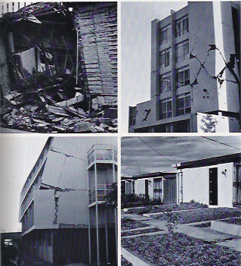
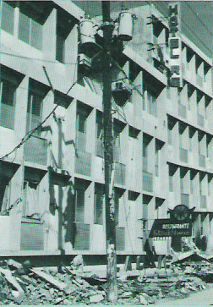
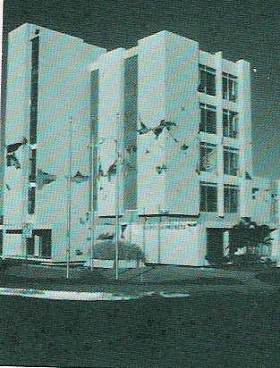
1972 Earthquake

Slide 8
Nicaragua
1974: Anastacio Somoza Debayle is decreed president of Nicaragua.
1978: By the end of the decade, Nicaragua experiences an economic slowdown and circumstances are ripe for a revolution. Joaquín Chamorro, editor of the anti-Somoza newspaper, La Prensa, is assassinated. The public holds Somoza responsible. Led by the Sandinista National Liberation Front (FSLN), anti-Somoza guerrilla forces launch a violent uprising against the military. Nicaragua is plunged into a near civil war.

Slide 9
Nicaragua
1979: Somoza resigns on July 17th, and flees to Miami, exiling to Paraguay. On July 20th, Sandinista forces enter Managua, and hundreds of thousands of Nicaraguans celebrate their triumph.
1980: Somoza is assassinated in Paraguay.

Slide 10
Nicaragua as US Ally
1954: Somoza sends mercenary forces to Guatemala to help U.S. forces oust socialist president, Jacobo Arbenz.
1955: Somoza pulls Nicaraguan troops from the Dominican Republic, who have intervened with U.S. military operations.
1961: US mercenaries depart from Nicaragua's Puerto Cabezas and invade Playa Girón, Cuba. They suffer a historical defeat known as the "Bay of Pigs."

Slide 11
Nicaragua as US Ally
1966: During a visit to the U.S., President Schick volunteers Nicaragua to serve as an U.S. military base for invading Cuba.
1967: Somoza Debayle offers soldiers from his National Guard to fight in the Vietnam War.
(Source: http://www.stanford.edu/group/arts/nicaragua/discovery_eng/timeline/ )

Slide 12
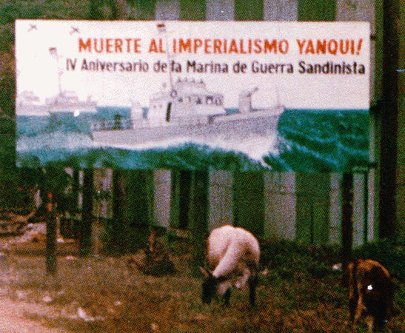
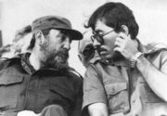
The Revolution

