Slide 1
JFK and LBJ
The Cold War Deepens

Slide 2
From Ike to JFK
“The Eisenhower administration’s remarkable lack of appreciation for the significance and depth of Latin American bitterness over US policy—at least until the anti-Nixon riots of 1958—had been baffling, if not frightening to many Latin American leaders. Kennedy attempted to exploit this negative mood in the election campaign against his Republican opponent, Richard M. Nixon, with an anticommunist twist, charging that the Eisenhower administration had allowed Cuba to become ‘communism’s first Caribbean base’ (Raymont, 127).

Slide 3
JFK’s Approach to LatAm
A Combo:
Idealism
Cold War Realism
“[T]he Kennedy approach must be viewed in the context of both its reformist impulse and the predicament caused by the alarm that existed in the United States over Cuba as a gateway to Soviet expansionism in the Western Hemisphere” (Raymont, 135).

Slide 4
…if people think they have to choose between communism and not eating, they’ll go for communism. Wouldn’t you? I would.
(Kennedy as quoted in Raymont, 151)

Slide 5
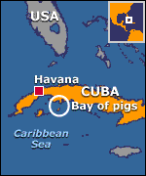
JFK
Bay of Pigs (Bahía de Cochinos)
Origins in the Eisenhower administration
Guatemala was the model
Cuban exiles trained in Guatemala
Alliance for Progress
comparisons to FDR
anti-Communist element
Rostow and developmentalism

Slide 6
JFK
“Planning represented a break with the mentality of an earlier generation which accepted Latin American poverty as a natural consequence of Latin inferiority” -Felipe Pazos. Director of ECLA/CEPAL (as quoted in Smith 200:151).

Slide 7
JFK
Coups continue:
Argentina (March 1962)
Peru (July 1962)
Guatemala (March 1963)
Ecuador (July 1963)
Dominican Republic (September 1963)
Honduras (October 1963).

Slide 8
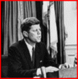
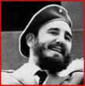
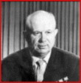
JFK
US still has to deal pragmatically with dictators
Cuban Missile Crisis

Slide 9
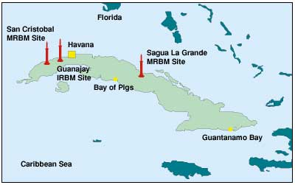
http://www.atomicarchive.com/History/coldwar/

Slide 10
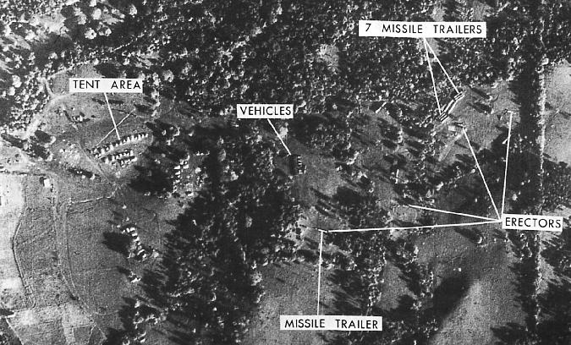
U2 photo of Cuba during missile crisis.

Slide 11
 | SS-4 SANDAL | SS-5 SKEAN
Warheads | Single | Single
Yield | 1-1.3/2-2/3 Mt | 1.0 or 2.0 -2.3 Mt
Range (km) | 2,000 km | 4500 or 3200 -3700 km
Background Information: | The SS-4 was the first Soviet strategic missile using storable propellants and a completely autonomous inertial guidance system. With its capability to deliver a megaton-class nuclear warhead the rocket provided a capability to attack strategic targets at medium ranges. This system constituted the bulk of the Soviet offensive missile threat to Western Europe. It was deployed at both soft launch pads and hard silos. | The SS-5 was a single-stage, storable liquid-propellant, intermediate range ballistic missile. As with the SS-4, the Skean missile was a single stage missile with integral fuel tanks though it was larger and twice the maximum range.

Slide 12
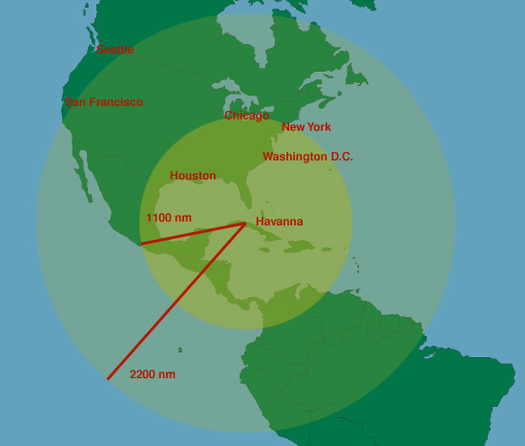

Slide 13
Hiroshima Before

Slide 14
Hiroshima After Estimated 16 kt yield

Slide 15
Hiroshima After (on the ground)

Slide 16
LBJ: 3 Crises
Panama
Clashes between students and soldiers in the Canal Zone.
Basic issue: sovereignty
Proximate cause: US flag flown w/o Panamanian flag alongside
Started as rioting
12 students killed, 300 wounded
4 soldiers killed

Slide 17
LBJ: 3 Crises
Panama broke off diplomatic relations (for about 3 months) with the US, and took complaints to the UN and OAS.
“I’m not going to be pushed around by a *** country no bigger than St. Louis”—LBJ to his adviser (Raymont, 163).

Slide 18
LBJ: 3 Crises
The Johnson administration perceived the whole affair as being one created by communist agitators with ties to Castro.
“From the outset, and perhaps unavoidably, the Panama crisis was cast by official Washington in terms of the Cold War. For most Latin American, however, the canal still loomed as a legacy of the days of Teddy Roosevelt and manifest destiny and a violation of the sovereignty of a sister republic” (Raymont, 163).

Slide 19
LBJ: 3 Crises
Gitmo
US Seizes some Cuban fishing boats
Cuba threatens to cut off water to Guantanamo base.
Much posturing, not much happens.
Reinforces the notion the Castro was an agitator and a general pain from the POV of the administration.

Slide 20
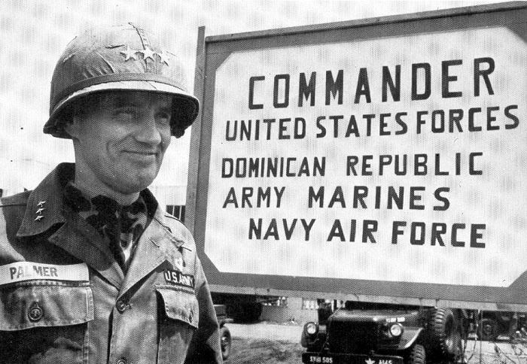
LBJ
The Dominican Intervention
Fears over “another Cuba”
“Your announced mission is to save American lives. Your unstated mission is to prevent the Dominican Republic from going Communist. The President has stated that he will not allow another Cuba” –General Earl Wheeler to Lt. General Bruce Palmer, Jr., commander of US forces in the DR (as quoted by Smith, 171).
Deployment of Marines (fourth to the DR in 58 years)
Brazil & avoiding “another China”
Alliance for Progress

Slide 21
Mann Doctrine
Named for Thomas C. Mann (Assistant Secretary of State for Economic Affairs in the in the last year of the Eisenhower administration and ambassador to Mexico and named Chief Administrator for the Alliance for Progress under LBJ)
Promotion of Economic Growth with Absolute Neutrality on Social Reform
Protection of US Private Investments
Display no Preference (through aid or other means) for Representative Democratic Institutions
Opposition to Communism
(Source: Smith 2000:157)

