Slide 1
Nixon & Ford
The Cold War Continues

Slide 2
Nixon
Context
Past history not stellar
Staunch anti-Communist
Vietnam was the big issue of the day.
By 1973 only three democratic states in the region (Colombia, Costa Rica and Venezuela). Mexico was a non-military authoritarian state.

Slide 3
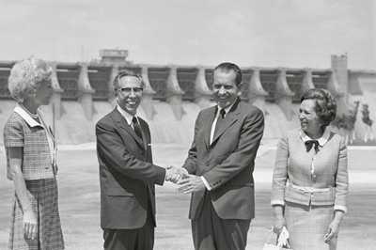
Nixon and the Region
Did not visit the region in six years (save for a brief trip across the Mexican border: inauguration of the Amistad dam
President Richard Nixon and Mexico's President Gustavo Diaz Ordaz shake hands at a ceremony on the Mexico side of the Rio Grande River after dedicating the Amistad Dam, in background. September 8, 1969

Slide 4
Nixon and the Region
“Low Profile”/“No Profile”
Rockefeller Report (see 185-186)
“Trade not Aid”
Support for military regimes
Preference for cooperation over confrontation
War on Drugs
Operation Intercept

Slide 5
Chile
Chile
In Nixon's memoirs, he said he quoted an informant who told him that Latin America could become "a red sandwich" with Cuba on one side and Chile on the other. He directed the CIA to "make the Chilean economy scream."
(Source: http://www.washingtonpost.com/wp-dyn/content/article/2006/12/10/AR2006121000302_3.html)

Slide 6
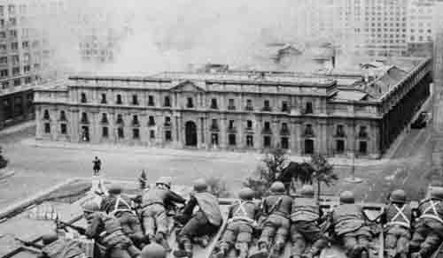
Chilean Coup: September 11, 1973

Slide 7
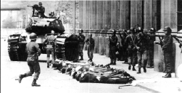
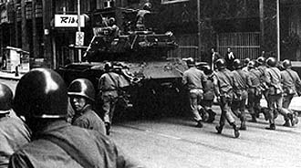
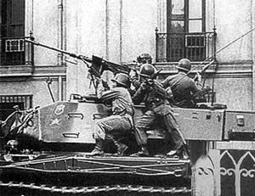
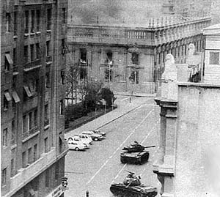
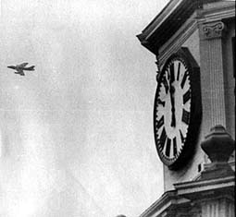
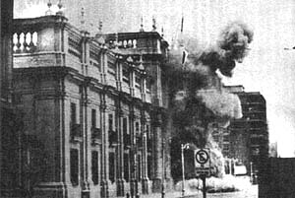
Chilean Coup

Slide 8
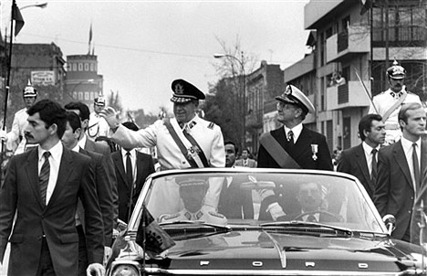
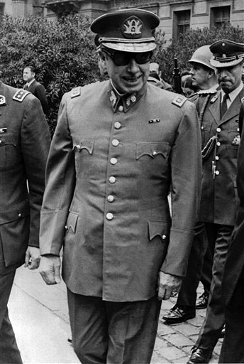
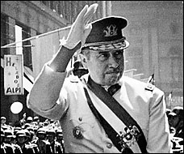
General Augusto Pinochet

Slide 9
General Augusto Pinochet
Appointed to be head of the Army by President Salvador Allende (indeed, Commander-in-chief less than a month before the coup)
Led Chile solely from 1974-1990 (led military junta 1973-1974)
Remained Commander-in-chief until 1997
Senator for life (under constitution he wrote) (retired in 2002)
Died on December 10, 2006

Slide 10
Pinochet’s Rule
3,197 confirmed dead and missing
Approximately 29,000 tortured
De-politicization of Chilean society
Referendum on new Constitution and confirmation of Pinochet as President in 1981
Referendum on new term in 1988
Free elections in 1989

Slide 11
Ford
Context of Watergate/a short presidency
Assistant Secretary William D. Rogers
Kissinger travels to LA
More dialog

